Slide 1
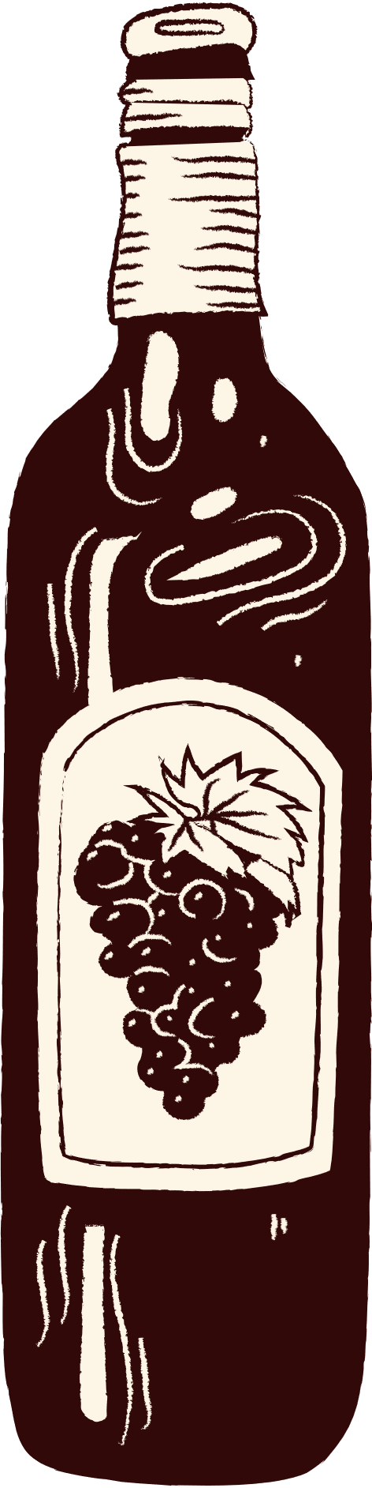
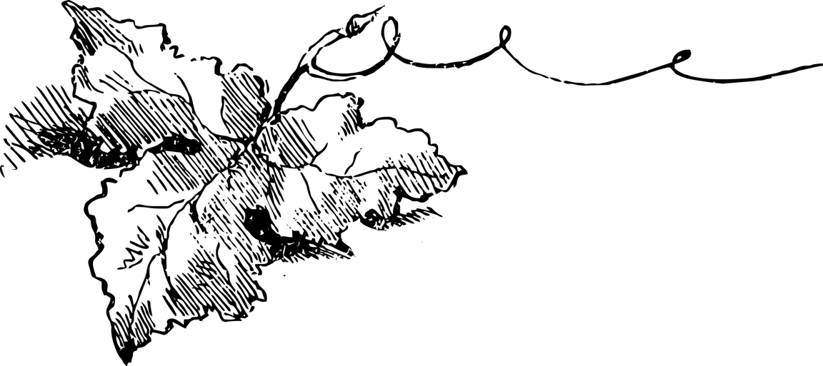
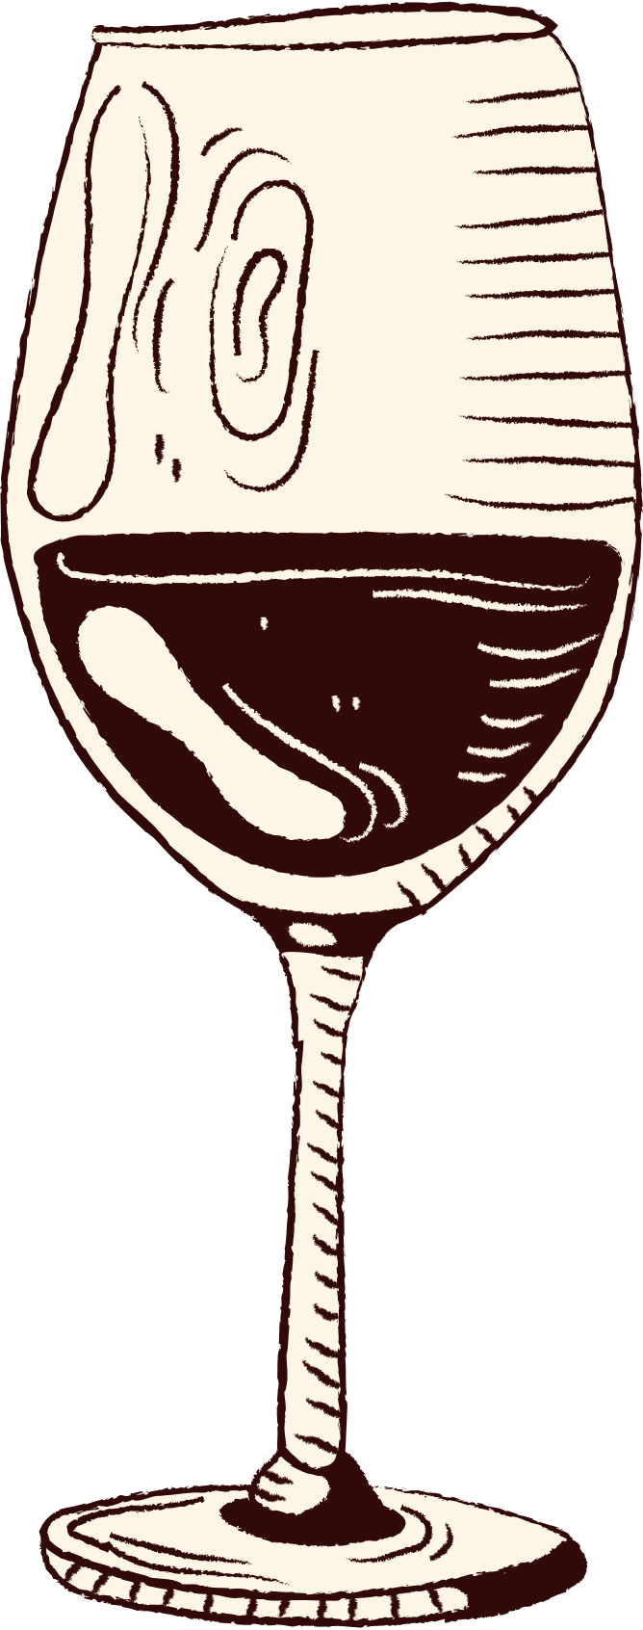

CATALOG
Wine
Quality
POUR DECISIONS MADE RIGHT : PREDICTING WINE QUALITY WITH MACHINE LEARNING
—Apeksya

Slide 2
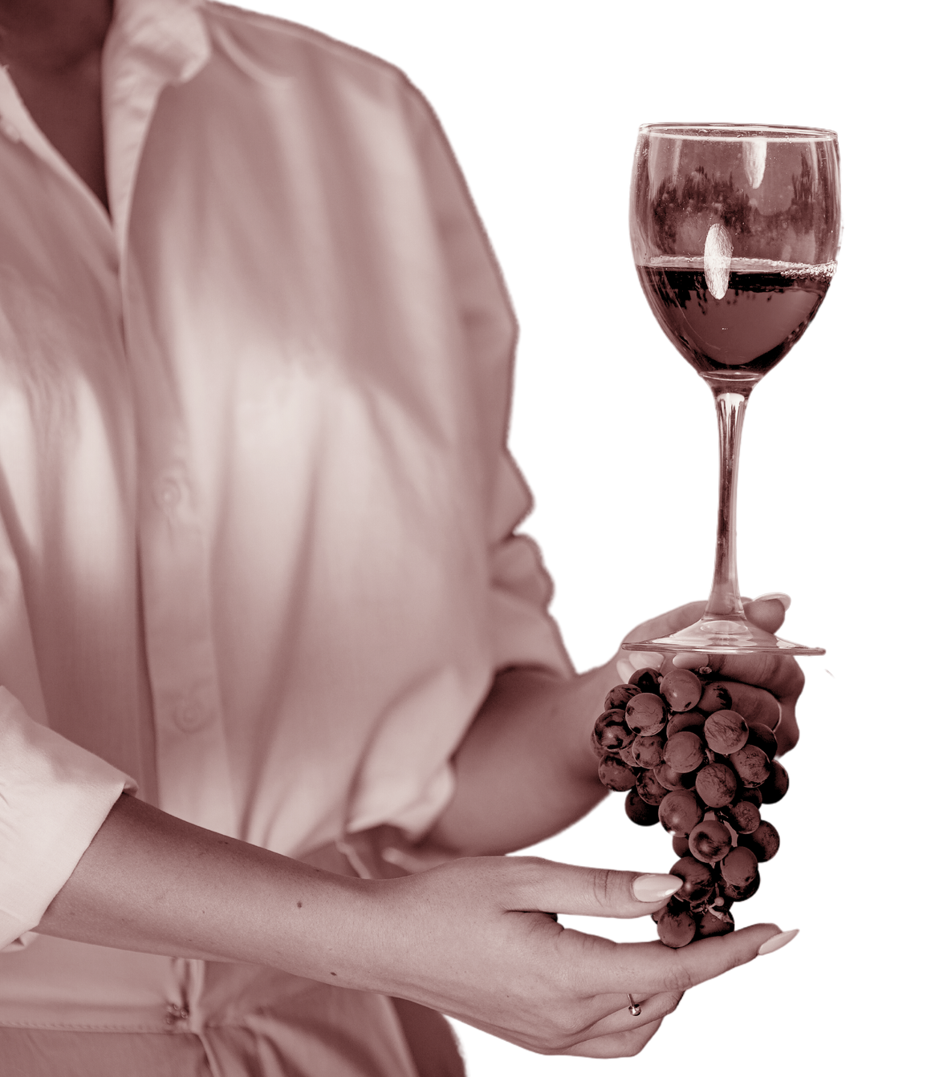
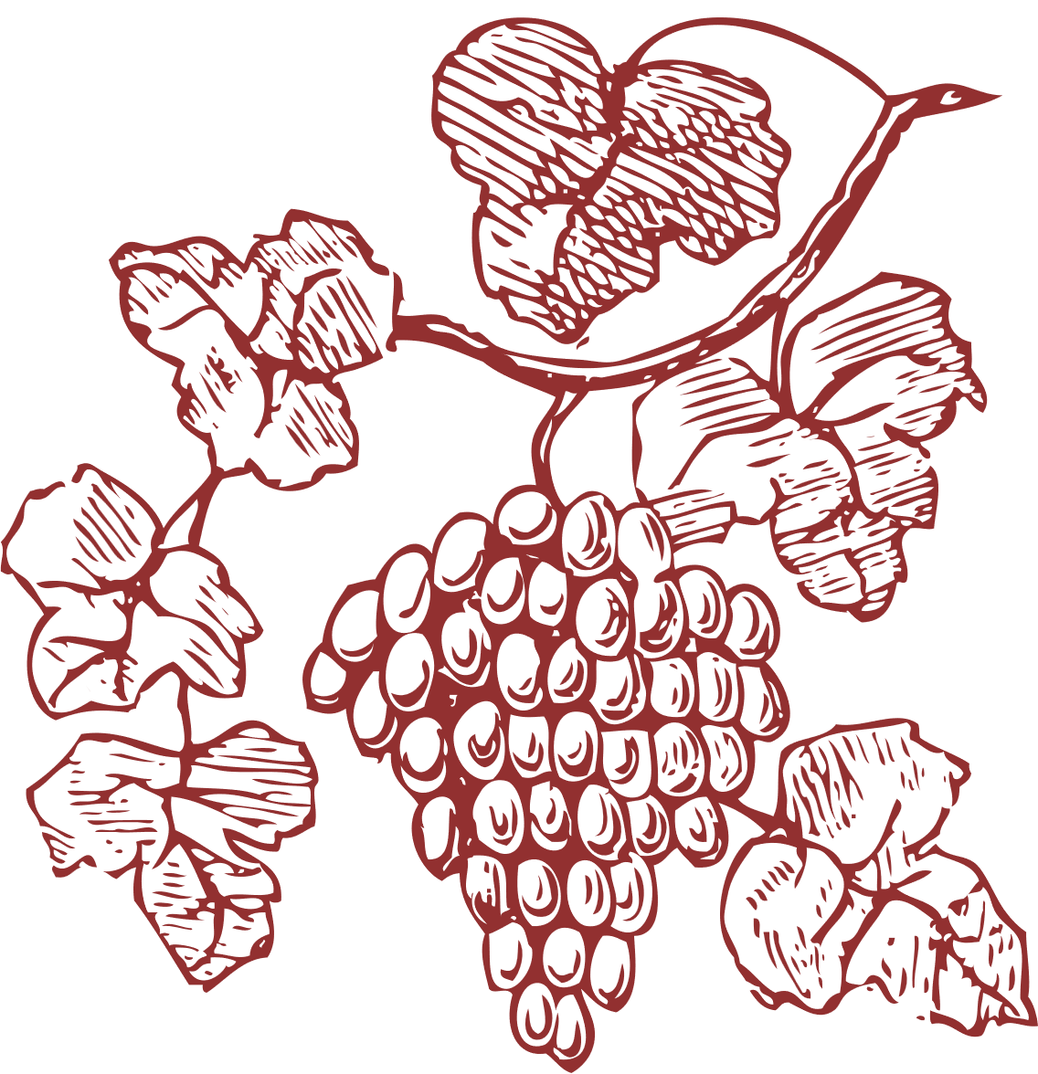
The discovery of a wine is of greater moment than the discovery of a constellation. The universe is too full of stars.
— Benjamin Franklin

Slide 3

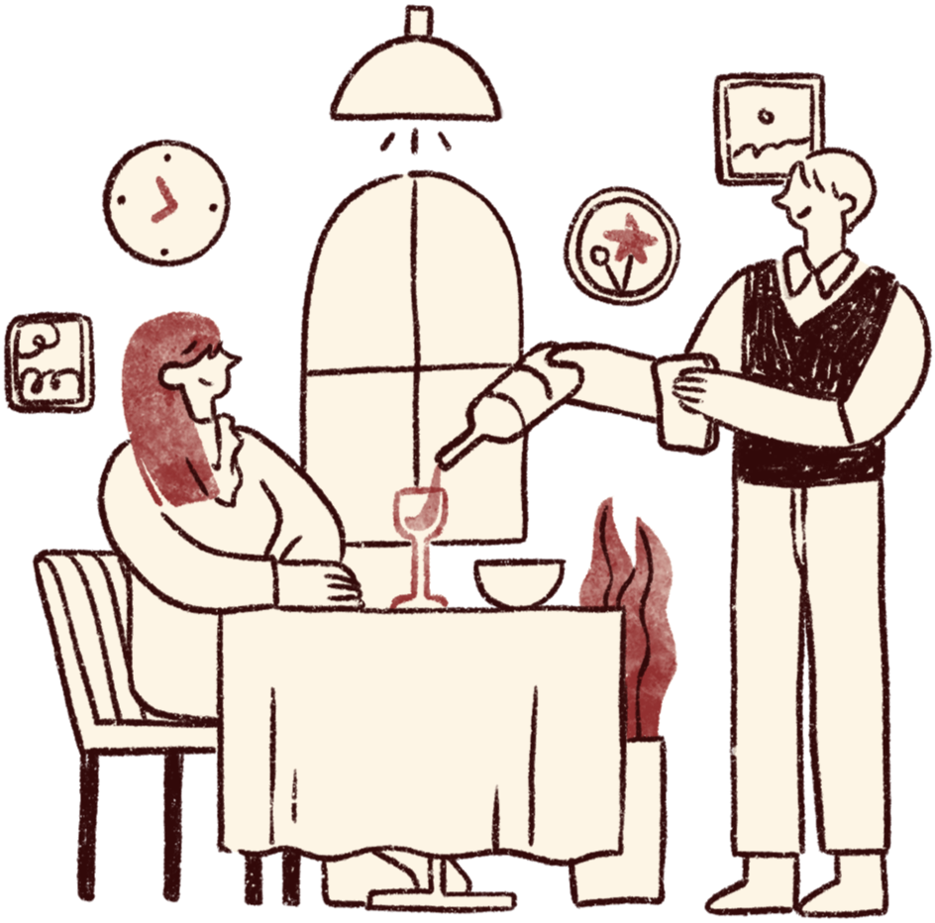
Introduction to Domain
Sipping a glass of wine is more than just indulging in a drink. It is about experiencing an art, a moment shared by many. But what makes a bottle of wine excellent or just another average ?
What determines wine quality?
Is it the alcohol content?
Is it the acidity?
The sweetness?
Or perfect balance of all the features?
Imagine relying on solely on
Manual testing or preferences
to rate wine quality.It seems
very inconsistent, time consuming
as well as influenced by
individual bias.
The wine industry which is values at over $330 billion globally faces challenges in accurately assessing the quality of wines which traditionally has been done by tasting, smell and appearance. Wine experts, critics and enthusiasts often have varying opinion on what constitutes “good quality” which can be biased and confusing.
The core problem is the lack of standardized method to predict wine quality. Without accurate predictions, consumers might end up with bad wines and wineries may struggle to improve production methods

Slide 4

OUR Project as the Solution?
Our project takes a deep dive into the fascinating world of wine, where each feature, from chemical composition to sensory taste plays a critical role in classifying the quality . By analyzing key features, our model ensures efficient and accurate quality assessments.
Whether you are a winemaker, a retailer or an enthusiast looking for your next favorite bottle, our system promises to bring clarity to the complex craft to select perfect wine for you.

Slide 5
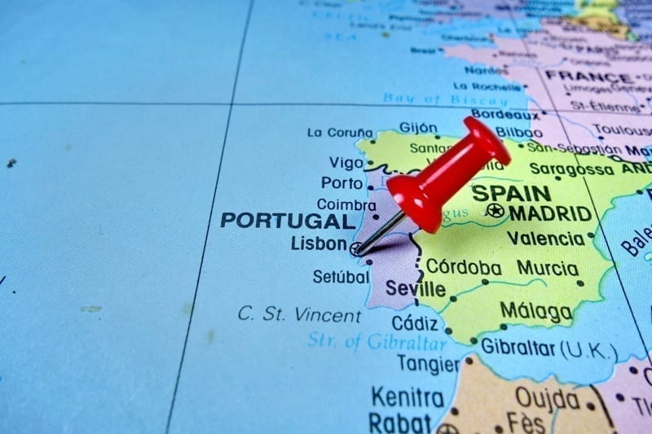

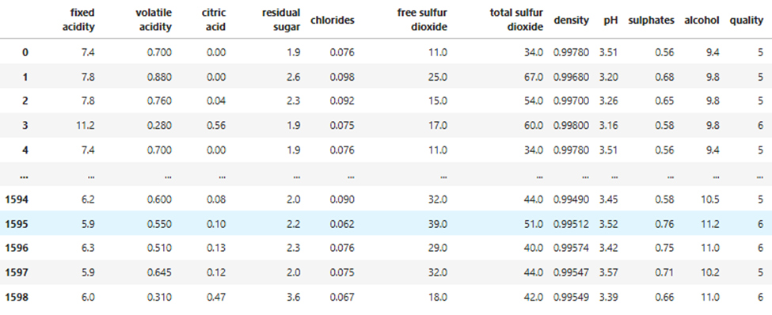
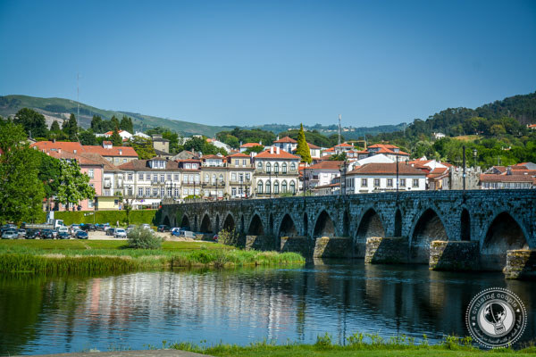
The dataset used in this project is extracted from the UCL machine repository. The dataset consist of both red and white wine variations of the Portuguese “Vinho Verde” wine which is a unique product from the Minho (northwest) region of Portugal.
DATASET

Slide 6
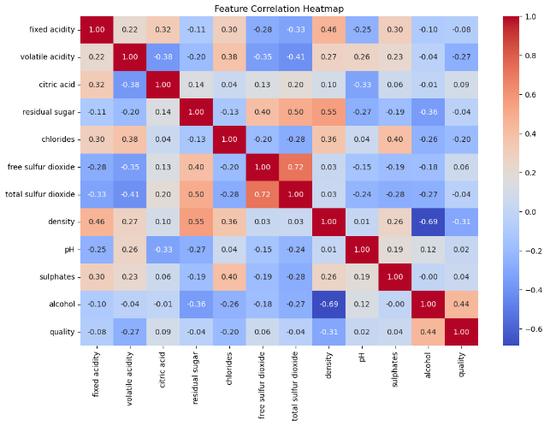
FEATURE CORRELATION

Slide 7

Introduction to domain & ITs Concepts
What is Machine Learning?
It is simply a method of getting computers to learn and act like humans do.
Wait what?
Imagine a child learning how to differentiate between cats and dogs through pictures. They notice differences by patterns like whiskers and ears.
The child is computer in this case and the pictures are our dataset which we keep on showing or feeding to computers

Slide 8
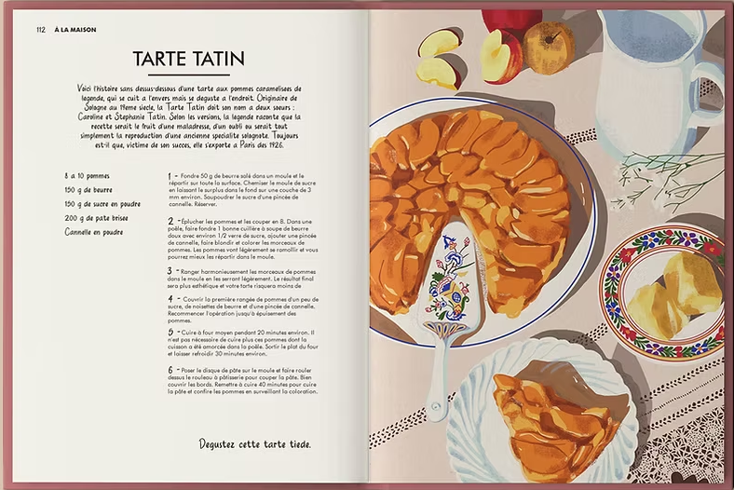
What is Algorithm?
An Algorithm is just a set of step by step instructions for solving a specific problem. Its same as recipes that we follow to cook a food but its used by computer to solve problems
In Machine Learning
It acts as a guide or steps to help the machine learn from the data we feed and make a decision by itself.
How it works ?
It learns from a bunch of data like text, numbers, etc. It looks at data and find patterns in the data. For eg: more percentage of sweet means sweeter wine. Then after algorithm uses this knowledge to learn and make decision

Slide 9

TYPES OF ML ALGORITHMS
Supervised Learning
unSupervised Learning
Think of teacher teaching a child how to recognize fruits by showing you the fruit and also telling you what is called.
Entering a room and noticing people wearing different colored shirts and grouping them according to colors(pattern) by yourself
.
SEMI –SUPERVISED
LEARNING
Reinforcement learning
Using few photos of cats and dogs with its identification and identifying other photos with help of it
Think of it like a game where you learn by trial and error getting rewards or losing points based on your actions.
.

Slide 10
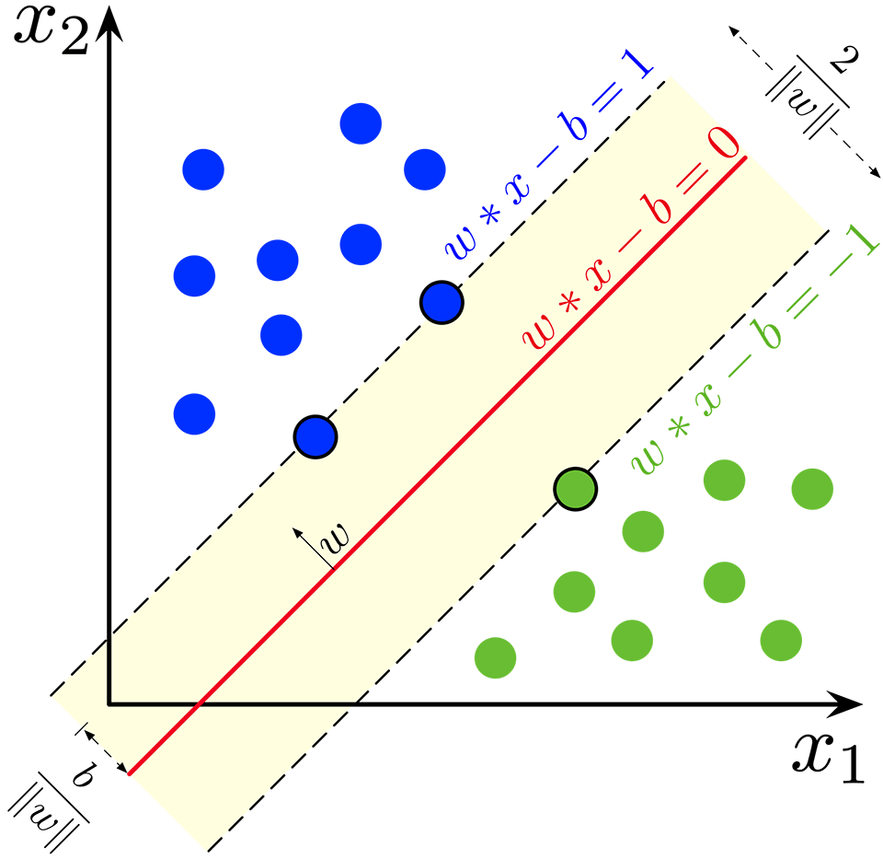
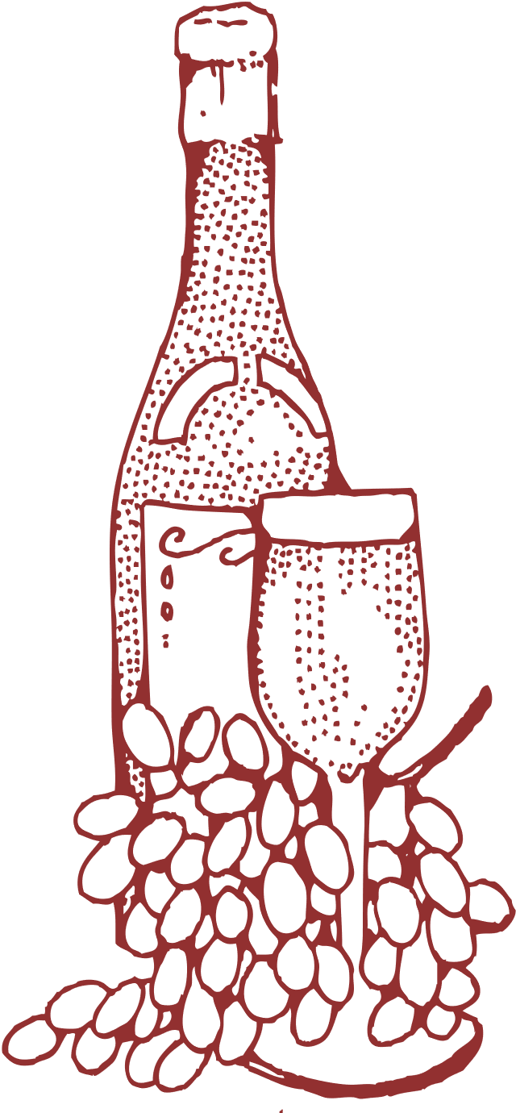

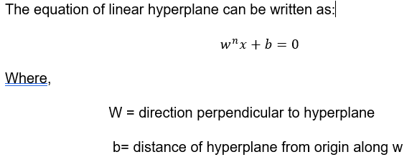
ALGORITHMS USED IN THE PROJECT
In this project, classification algorithms such as Support Vector Machine, Decision Tree and Bagging Classifier is used.
Support Vector Machine:
The algorithm classify the object by drawing a hyperplane so that the category is separated. The algorithm selects a hyperplane and calculates its positive and negative hyperplane parallel to the original hyperplane which touches the closest vector from the hyperplane.
SVM algorithm finds w and b where the distance or the margin between positive and negative hyperplane is maximum.

Slide 11
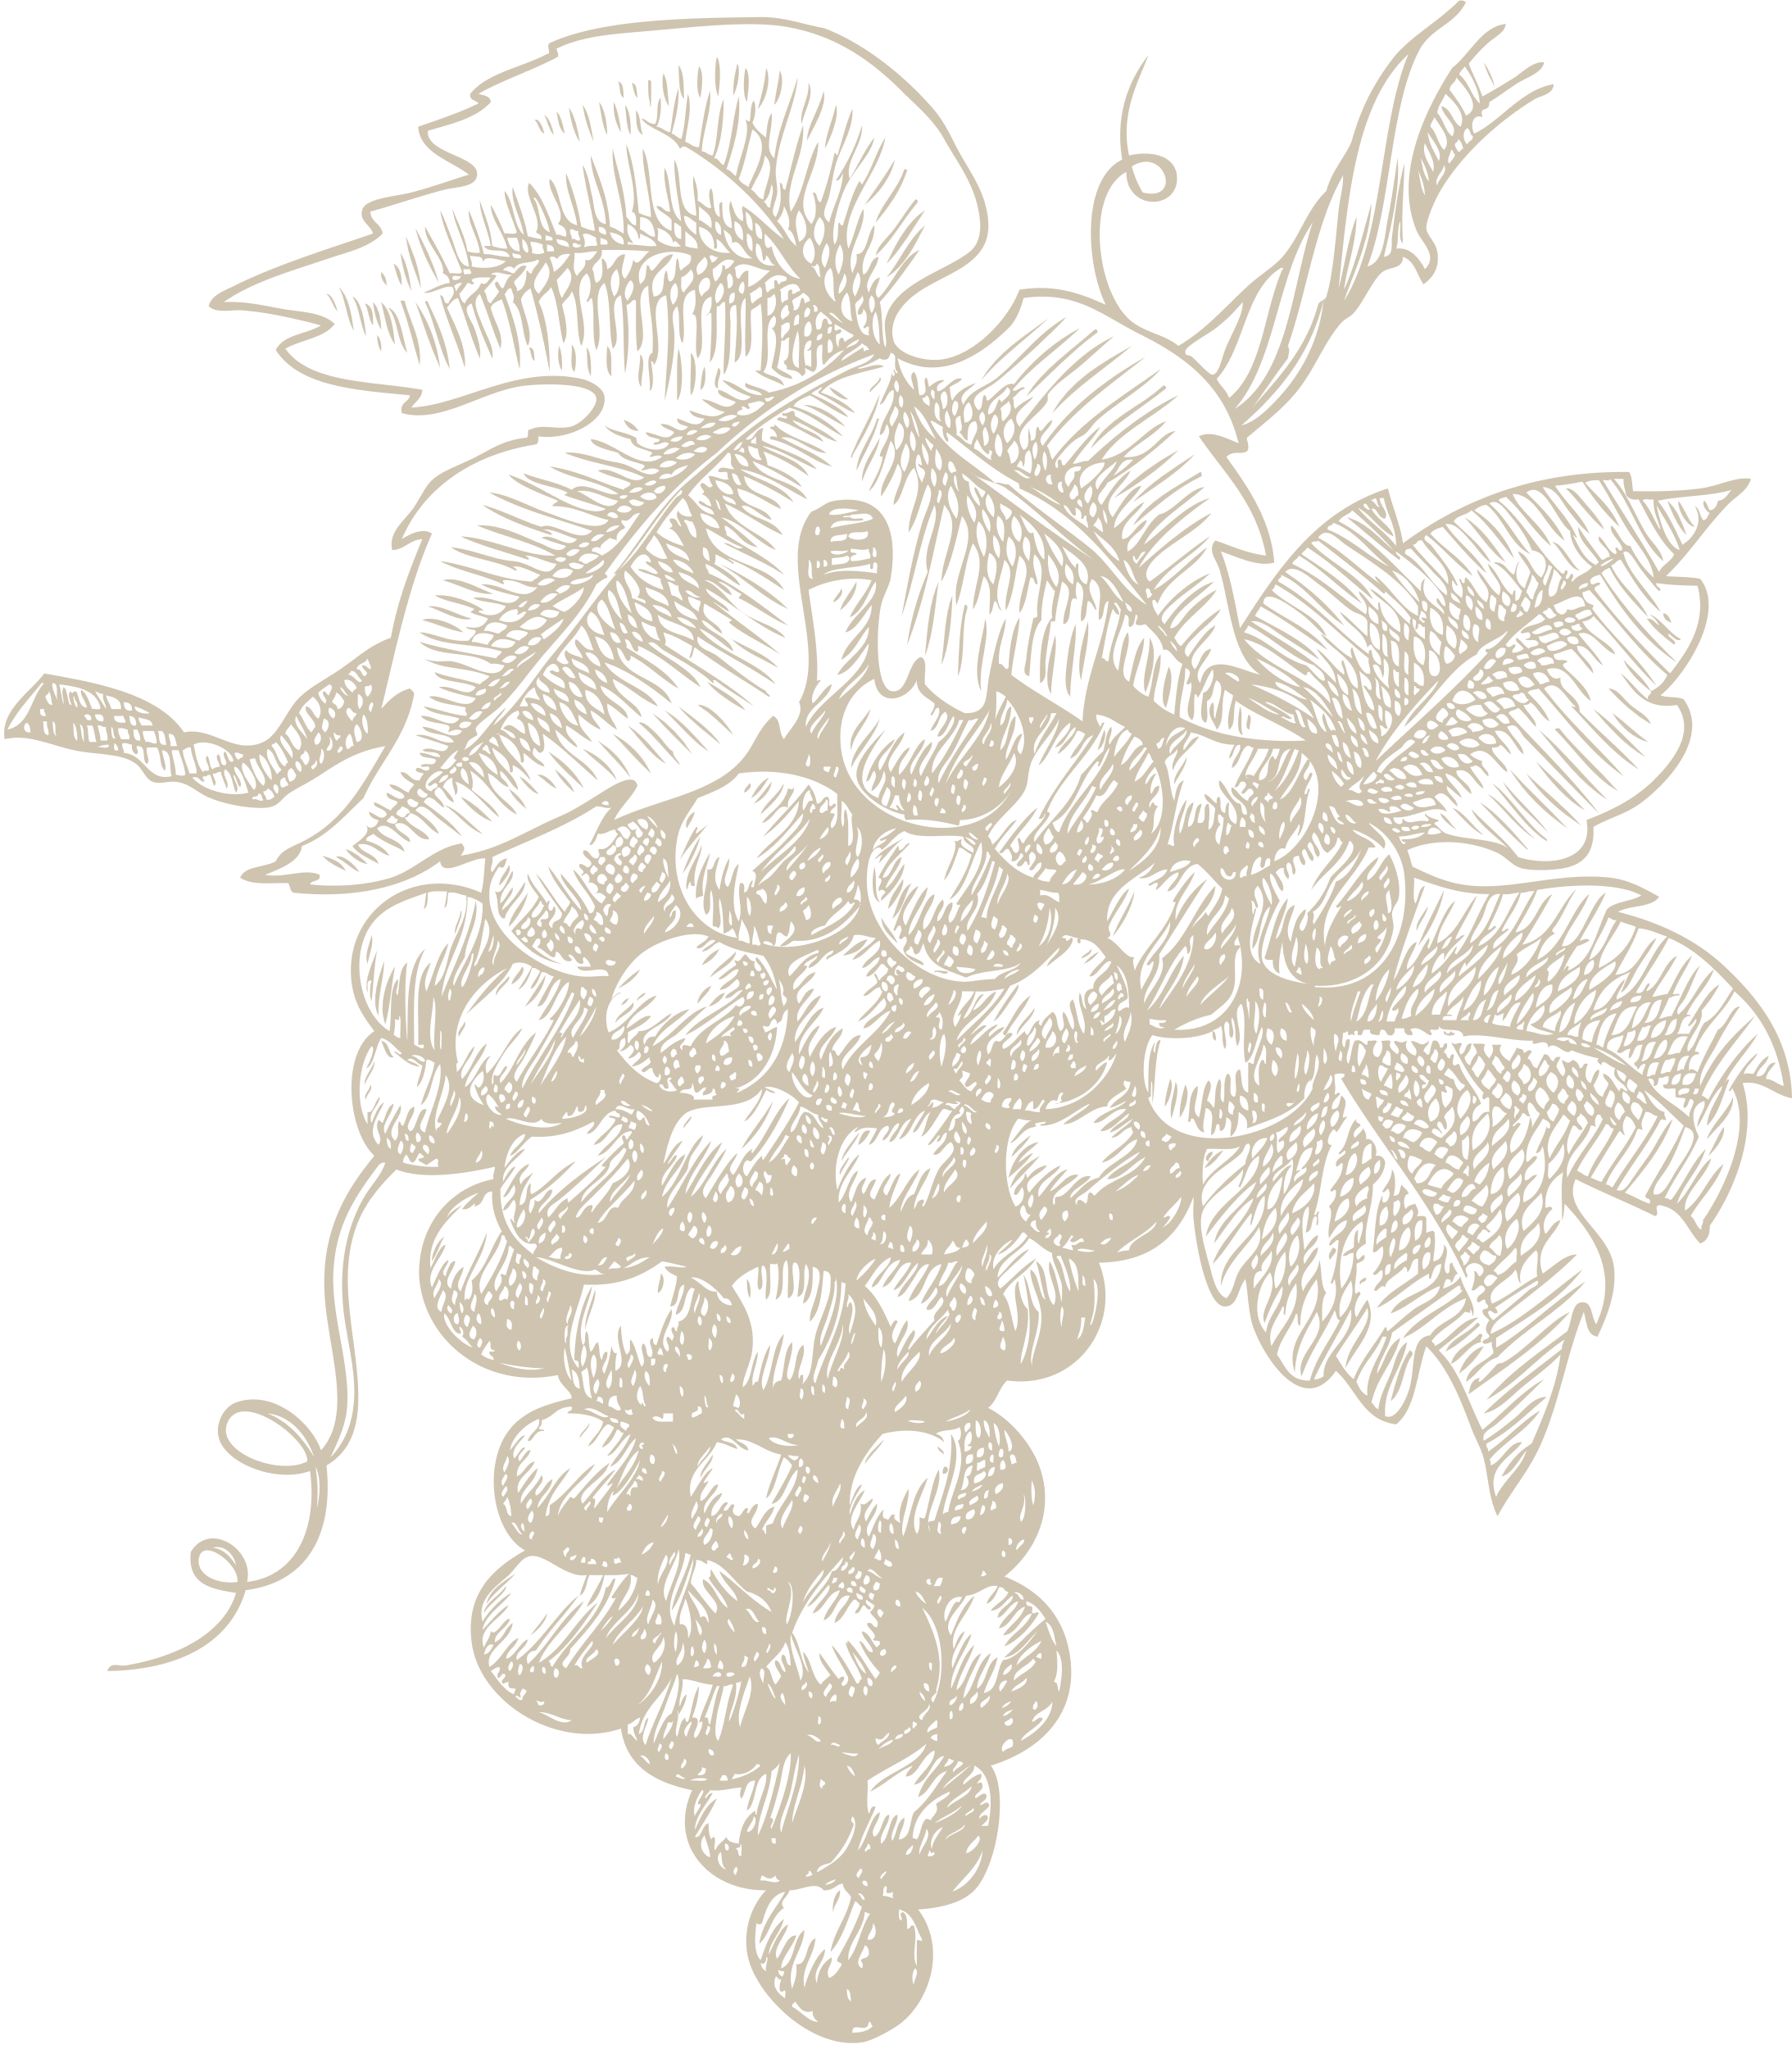
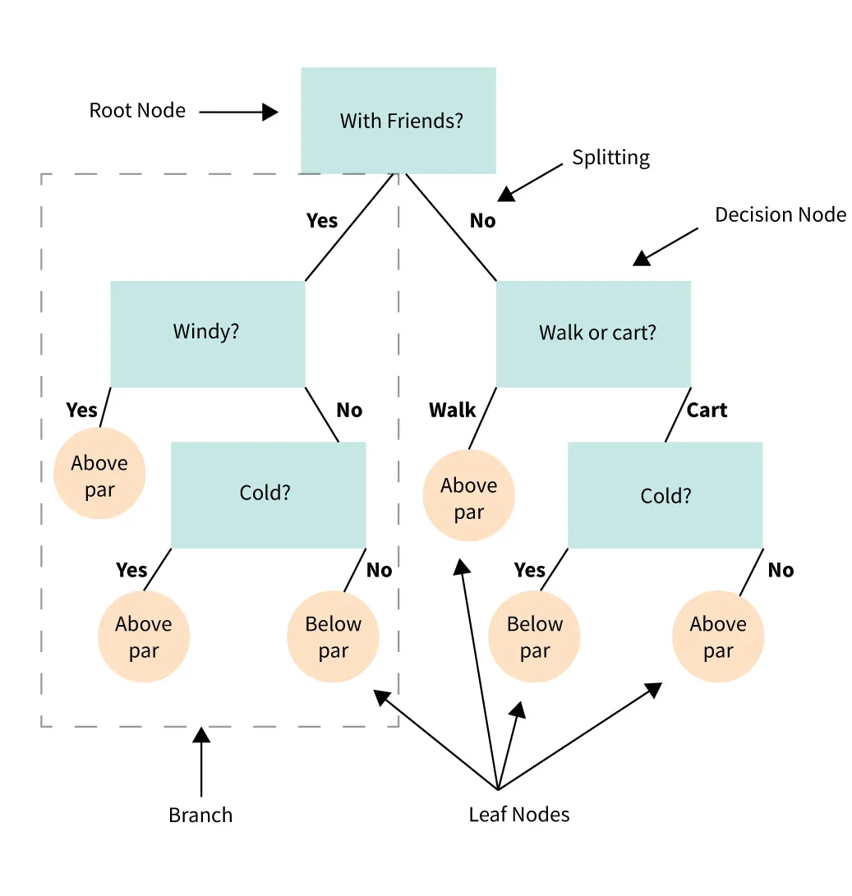
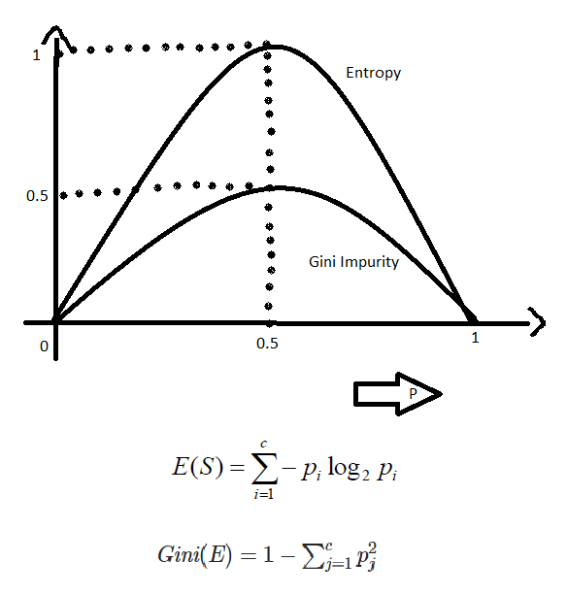

ALGORITHMS USED IN THE PROJECT
Decision Tree Classifier:
This algorithm starts with a root node and ends with a decision which is made by leaves. The root node represents the entire sample and sub-node are split from the root node which is then split further called as decision node. The nodes that donot split is called a leaf.
The nodes are split of criteria which are gini index and entropy. Less entropy and gini index means more pure data. So the algorithm chooses the feature with the lower value of the splitting criteria.
.

Slide 12
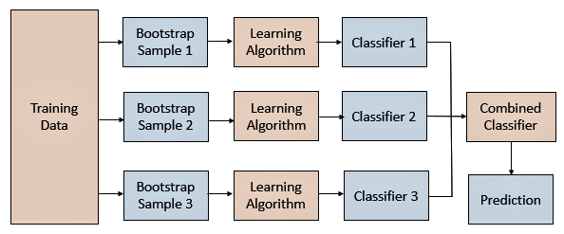
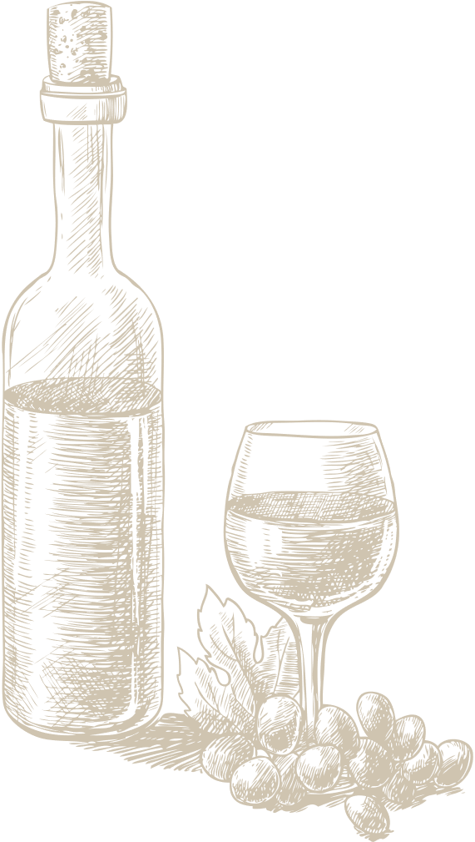
ALGORITHMS USED IN THE PROJECT
Bagging Classifier:
This algorithm is also known as bootstrap aggregation. This algorithm works on low bias low variance mechanism which helps with outliers, skewness as well as overfitting. It works by generating numerous subset of data and group of base learners such as decision tree learn together and give results.
.

Slide 13

DEVELOPMENT PROCESS
Data Preprocessing
Data preprocessing is a crucial step in the
machine learning pipeline. It’s like
preparing the ingredients before cooking a
meal: you need to clean, organize, and get
everything ready for the algorithm to use.
In the context of wine prediction, we take raw, messy data and transform it into a structured and cleaned-up format that helps model make accurate predictions.
Steps in Data preprocessing:
Dataset Import
We load the dataset from the UCL Machine Learning repository, ensuring proper formatting and merging two separate datasets for red and white wines.
Implementation: Red wine and white wine datasets are merged, with an additional column to differentiate between the two wine types.
Dropping Duplicate Values
Duplicate records can distort analysis and model predictions by providing redundant information. Removing them ensures data quality.
Implementation: If two entries list identical wine properties and quality ratings, they are considered duplicates and removed to prevent skewing the results.
Handling Missing Values
Missing values can lead to incorrect predictions and hinder the model from detecting accurate patterns. Filling these gaps ensures consistency.
Implementation: If alcohol content is missing for certain wines, we fill these values with the average alcohol content of the dataset.

Slide 14


DEVELOPMENT PROCESS
Exploratory Data Analysis (EDA)
EDA helps to understand the dataset’s structure, distribution, and relationships among features.
Implementation: Heatmaps identify correlations among features (e.g., alcohol correlating strongly with quality), while histograms reveal skewed distributions, guiding scaling and outlier treatment.
Feature Engineering
Transforming or creating new features improves model performance by focusing on meaningful representations of the data.
Implementation: Quality scores (1–10) are converted into "good" and "bad" categories to simplify and improve the classification task
Feature Selection
Selecting key features reduces complexity and enhances the model by retaining relevant information.
Implementation: A highly correlated feature like "total acidity" is removed if its effect overlaps with "volatile acidity," minimizing redundancy.
Data Balancing
Balanced data ensures the model treats all classes fairly, avoiding bias toward the overrepresented class.
Implementation: SMOTE creates synthetic samples for the underrepresented "good" wine class, balancing it with the "bad" wine class.
Feature Scaling
Feature scaling standardizes the range of data to ensure fair treatment of features with different units and magnitudes.
Implementation: Alcohol content (measured in %) and pH (unitless) are scaled using Z-score normalization, giving both features equal weight during training.

Slide 15

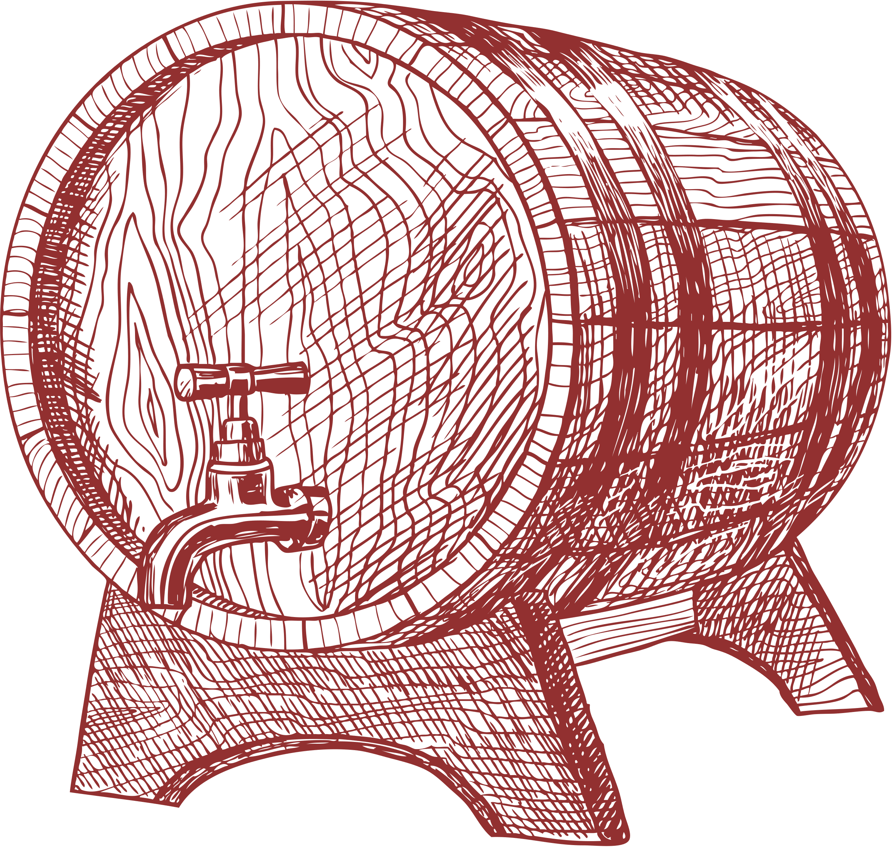
DEVELOPMENT PROCESS
Data Splitting
Splitting the dataset enables training the model on one subset and testing its performance on unseen data.
Implementation: The dataset is divided into training (80%) and testing (20%) subsets for model implementation..
Model Implementation
Training machine learning algorithms uncovers patterns, enabling them to make accurate predictions based on new data.
Implementation: SVM is trained on the training dataset, learning relationships between wine properties and quality, and tested on the testing set for accuracy evaluation.
Evaluation Metrics
Confusion Matrix: It is a table that summarizes the performance of model
True Positive: Correctly predicted positives.
True Negative: Correctly predicted negatives.
False Positive: Incorrectly predicted positives.
False Negative: Incorrectly predicted negatives.
Accuracy: Ratio of total correctly predicted values to total number of values.
Precision: Ratio of correctly positive predicted to all positive predicted.
Recall: Ratio of true positive to sum of true positive and false negative.
F1-Score: It is the harmonic mean of precision and recall.

Slide 16

Model | Class | Preicision | Recall | F1-Score | Accuracy
SVM Before Tuning | Bad | 0.94 | 0.80 | 0.86 | 0.87
 | Good | 0.81 | 0.95 | 0.88
SVM after Tuning | Bad | 0.97 | 0.89 | 0.93 | 0.93
 | Good | 0.89 | 0.97 | 0.93
Decision Tree Classifier | Bad | 0.95 | 0.88 | 0.91 | 0.91
 | Good | 0.88 | 0.96 | 0.92
Bagging Classifier | Bad | 0.98 | 0.90 | 0.94 | 0.94
 | Good | 0.90 | 0.98 | 0.94
RESULTS

Slide 17




FINDINGS
SVM was able to predict 93% of the samples correctly. Of all the samples predicted as bad, 97% of them were actually bad and of all the samples predicted as good, 89% of them were actually good.
Of all the actual bad samples, 89% of them were correctly predicted as bad and of all the actual good samples, 97% of them were correctly predicted as good.
The model shows significant improvement in accuracy and balanced predictions for both classes which indicates it effectiveness in capturing data more accurately
.
Decision Tree classifier was able to predict 91% of the samples correctly. Of all samples predicted as bad,95% of them were actually bad and of all samples predicted as good 88% were actually good.
Of all the actual bad samples,88% of them were correctly predicted as bad and of all the actual good samples,96% of them were correctly predicted as good.
It shows strong recall for good class but slightly lower precision as well as strong precision for bad with less recall which means that it might need slight improvement to predict the class accurately.
Bagging Classifier was able to predict 94% of the samples correctly. Of all the Of all the samples predicted as bad, 98% of them were actually bad and of all the samples predicted as good, 90% of them were actually good.
Of all the actual bad samples, 90% of them were correctly predicted as bad and of all the actual good samples, 98% of them were correctly predicted as good.
It shows strong precision and recall meaning as it has balanced F1-score which means that the model handles class distribution effectively.

Slide 18
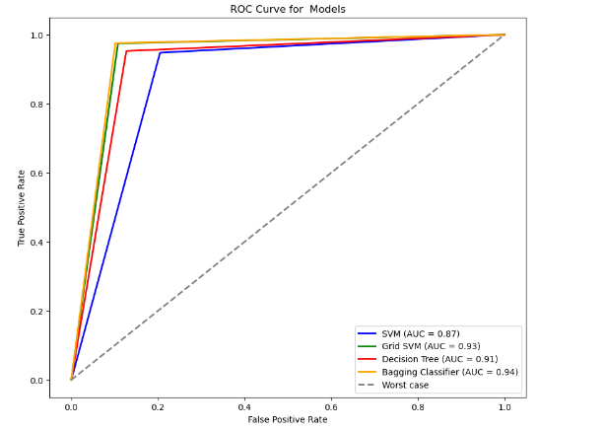

ROC AUC Curve

Slide 19

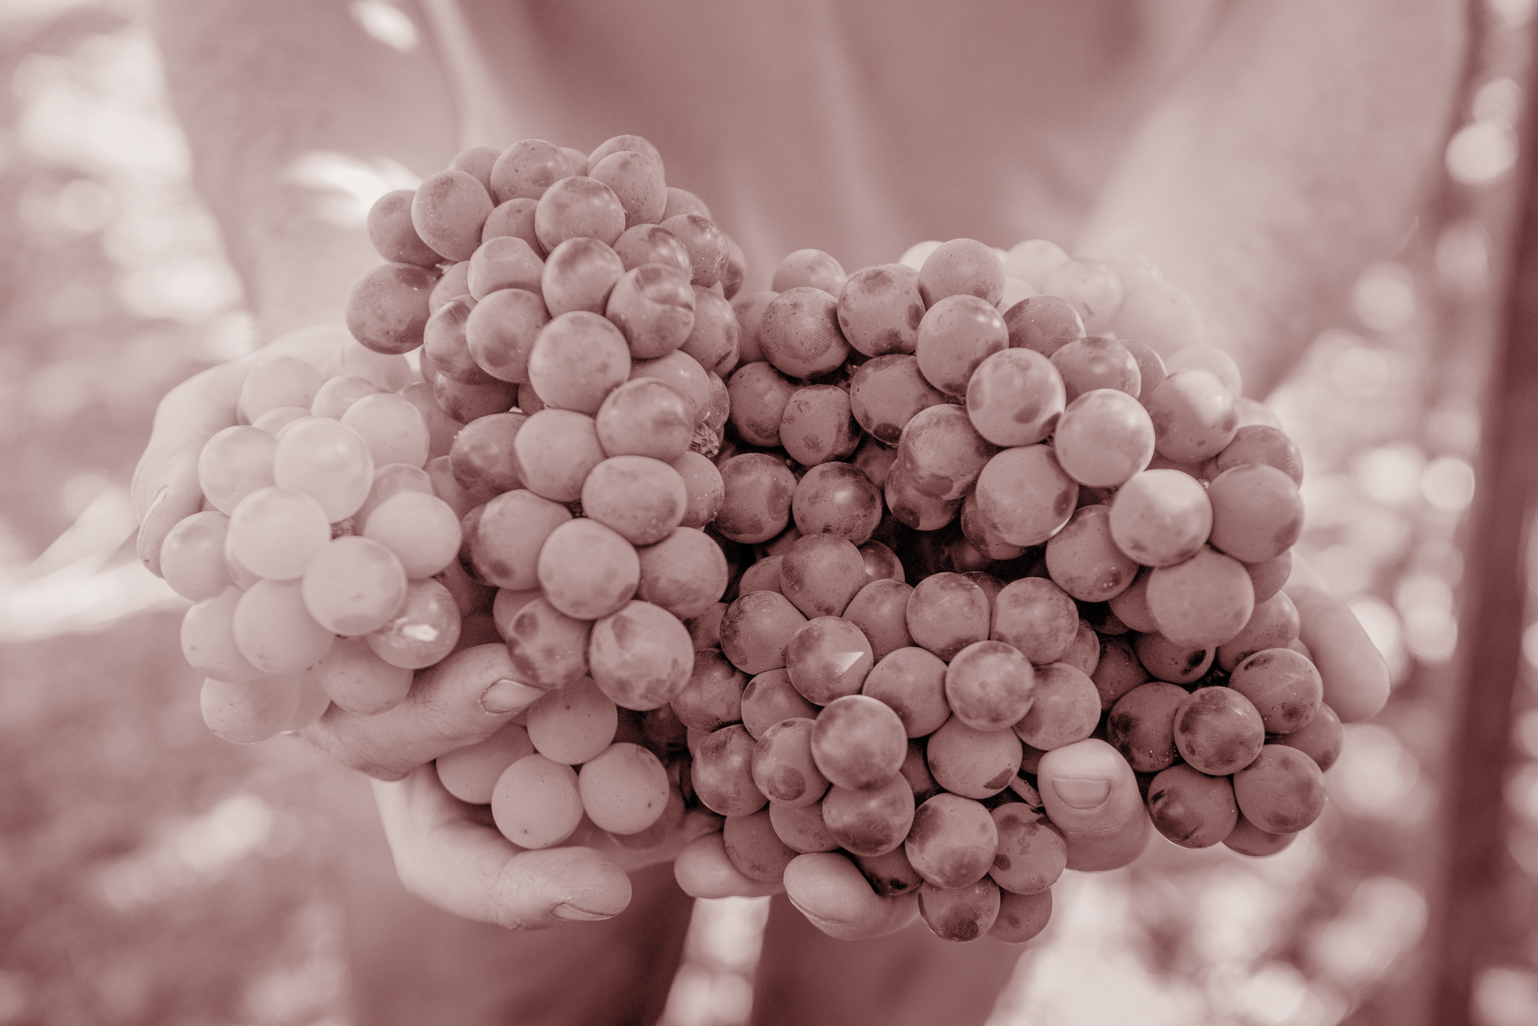
CONCLUSION
This project leverages ML to automate wine quality evaluation offering wineries with a valuable tool for enhancing production and boosting sales.
By analyzing the chemical properties, the project used models such as SVM, Decision Tree and Bagging Classifier with the achievement of 94% accuracy by Bagging Classifier. While the results are strong, further improvements can be made by advanced algorithms implementation and optimizing decision tree classifier.

Slide 20


THANK YOU !

